Slide 1

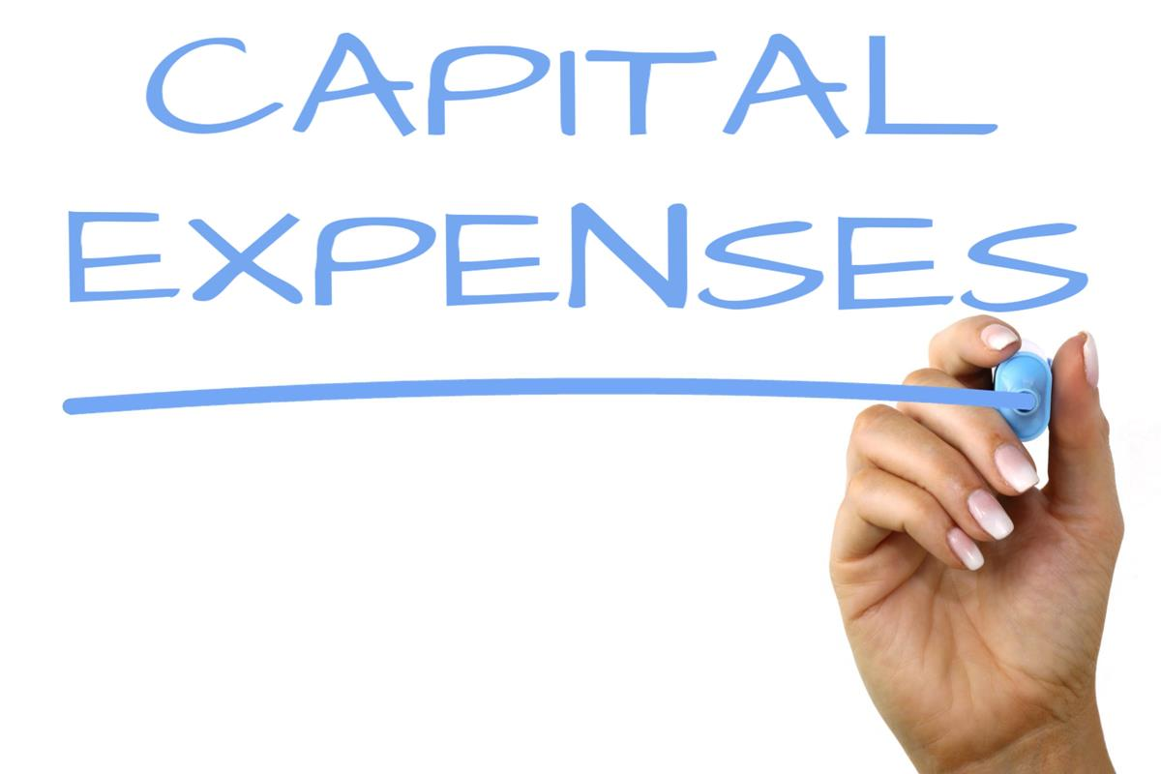
What is Revenue
&
This Photo by Unknown Author is licensed under CC BY-SA
This Photo by Unknown Author is licensed under CC BY-SA

Slide 2

What is Revenue?
Revenue: funds that flow into a business from its primary activity, such as the sale of products

Slide 3
Businesses earn revenue from various sources
What is the Primary Source of Revenue?
Total from the sales of goods or services
Other Sources
Subscriptions based pricing
Licensing – sell their copyrighted materials
Advertising and Sponsorships
Interest on their investments

Slide 4
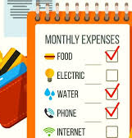
Sources of Expenses?
Expenses: costs incurred by a business in the process of generating revenue
Some common Examples include:
Cost to producing products or buying products to sell
Labor costs
Rent/Mortgage
Utilities (lights, heat, water etc…)
Advertising
Insurance
Taxes

Slide 5
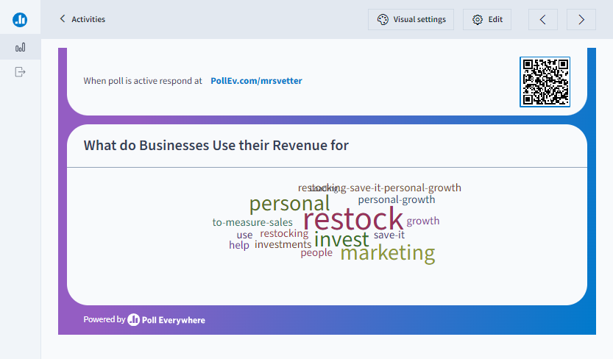

Slide 6

How Do Businesses Use Their Profits?
Various Ways:
Investing in R&D - research and development (New products)
Rewarding owners and shareholders
Expanding operations (global)
Investing in marketing
Repaying any debts
Improving employee compensation
Supporting social and environmental initiatives
Reinvesting in the business

Slide 7

Profit: When a business earns more than they spend
(More Revenue than Expenses)
Loss: When a business spends more than
they earn
(More Expenses than Revenue)
I am smiling
I am frowning

Slide 8



Assignment
1. Complete the Quick Write Activity in your packet.
2. Complete the Google Classroom Assignment Posted on Google Classroom: Profit and Loss Digital Math Activity

